Slide 1
COMP 3500 Introduction to Operating Systems Final Exam Review
Dr. Xiao Qin
Auburn University http://www.eng.auburn.edu/~xqin
xqin@auburn.edu
Notes:
Some TLBs store address-space identifiers (ASIDs) in each TLB entry – uniquely identifies each process to provide address-space protection for that process
Otherwise need to flush at every context switch
TLBs typically small (64 to 1,024 entries)
On a TLB miss, value is loaded into the TLB for faster access next time
Replacement policies must be considered
Some entries can be wired down for permanent fast access

Slide 2
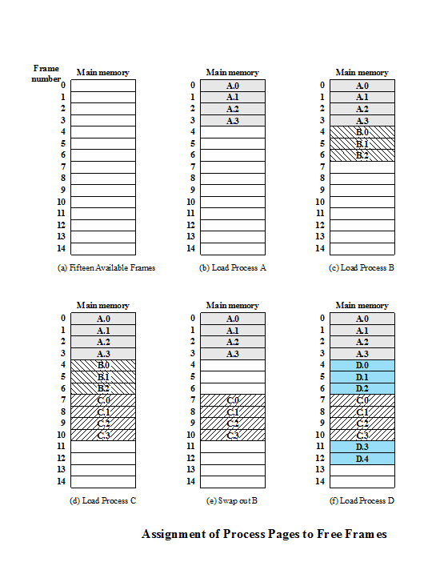
Paging
Partition memory into equal fixed-size chunks that are relatively small
Process is also divided into small fixed-size chunks of the same size
Notes:
Physical address space of a process can be noncontiguous; process is allocated physical memory whenever the latter is available
Avoids external fragmentation
Avoids problem of varying sized memory chunks
Divide physical memory into fixed-sized blocks called frames
Size is power of 2, between 512 bytes and 16 Mbytes
Divide logical memory into blocks of same size called pages
Keep track of all free frames
To run a program of size N pages, need to find N free frames and load program
Set up a page table to translate logical to physical addresses
Backing store likewise split into pages
Still have Internal fragmentation
Both unequal fixed-size and variable-size partitions are inefficient in the use of memory; the former results in internal fragmentation, the latter in external fragmentation. Suppose, however, that main memory is partitioned into equal fixed-size chunks that are relatively small, and that each process is also divided into small fixed-size chunks of the same size. Then the chunks of a process, known as pages , could be assigned to available chunks of memory, known as frames , or page frames. We show in this section that the wasted space in memory for each process is due to internal fragmentation consisting of only a fraction of the last page of a process. There is no external fragmentation.

Slide 3
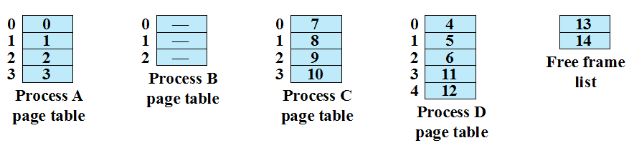
Page Table
Maintained by operating system for each process
Contains the frame location for each page in the process
Processor must know how to access for the current process
Used by processor to produce a physical address
Notes:
Page Table Examples

Slide 4
How to use a page table to perform logical-to-physical address translations?

Slide 5
Logical-to-Physical Address Translation Scheme
Address generated by CPU is divided into:
Page number (p) – used as an index into a page table which contains base address of each page in physical memory
Page offset (d) – combined with base address to define the physical memory address that is sent to the memory unit
For given logical address space 2^{m} and page size 2^{n}

Slide 6
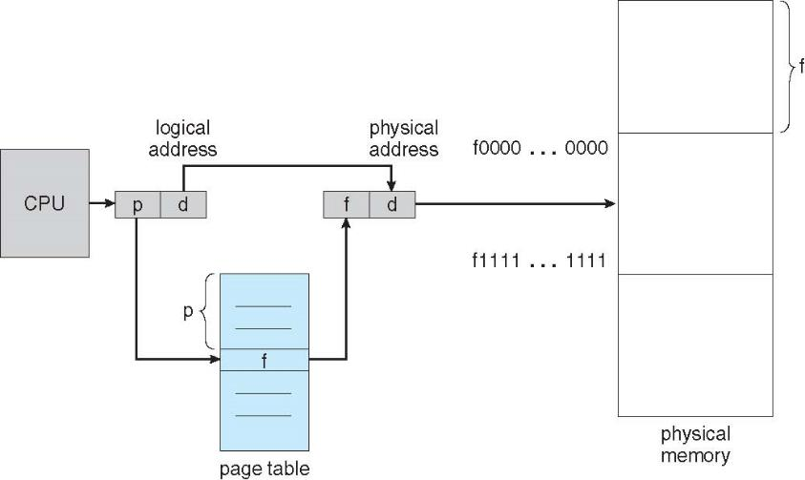
Logical-to-Physical Address Translations

Slide 7
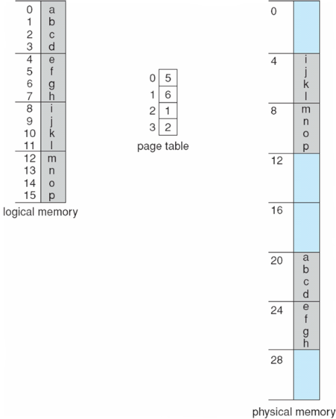
Page Table: An Example
What is the size of physical memory?
What is the page size?
How many bits are used as an index into a page table?
How many bits are used for page offset?
Notes:
n=2 and m=4 32-byte memory and 4-byte pages

Slide 8
Calculating Internal Fragmentation
Page size = 2,048 bytes
Process size = 72,766 bytes
How many pages are there in this process?
How many bytes are there in the last page?
What is the internal fragment?
What is the worst case fragmentation?
What is the average fragmentation?
Notes:
Explain what is internal fragment?
Example: page size 8 bytes. 5 bytes are used in a page. Then the internal fragment is 8-5=3 bytes (unused space).
Process view and physical memory now very different
By implementation process can only access its own memory

Slide 9
Are small frame sizes desirable?
Small frame size: small fragment
Small frame size: large table size
each page table entry takes memory to track
Page sizes growing over time
Solaris supports two page sizes – 8 KB and 4 MB
Notes:
Small frame size -> small fragment
Small frame size -> large table size

Slide 10
Two registers to support paging
Where should we keep page tables?
Where does the Page-table base register (PTBR) point at?
The Page-table length register (PTLR) indicates size of the page table. Why the Page-table length register (PTLR) is important?

Slide 11
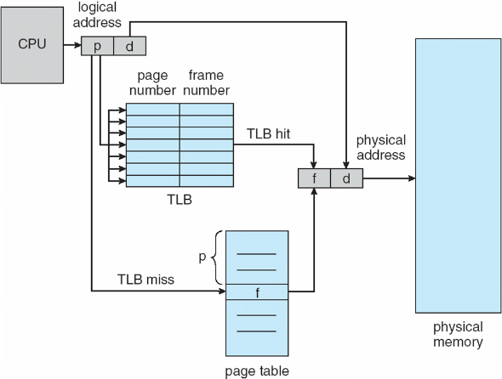
Paging Hardware with Translation Look-aside Buffers (TLB)

Slide 12
Parallel Searching the TLB
Associative memory – parallel search
Address translation (p, d)
If p is in associative register, get frame # out
Otherwise get frame # from page table in memory

Slide 13
What happens on a TLB miss?
Value (?) is loaded into the TLB for faster access next time
Replacement policies must
be considered
Notes:
What value? (page#, frame#) in the page table.
Replacement policies must be considered
Some entries can be wired down for permanent fast access

Slide 14
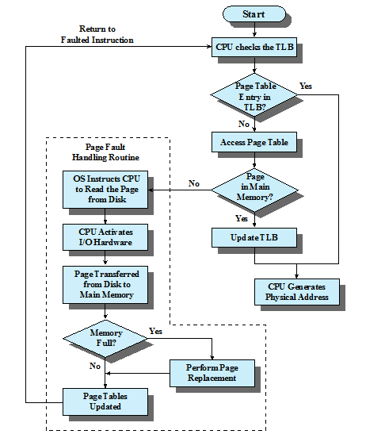
Paging and Translation Lookaside Buffer (TLB)

Slide 15
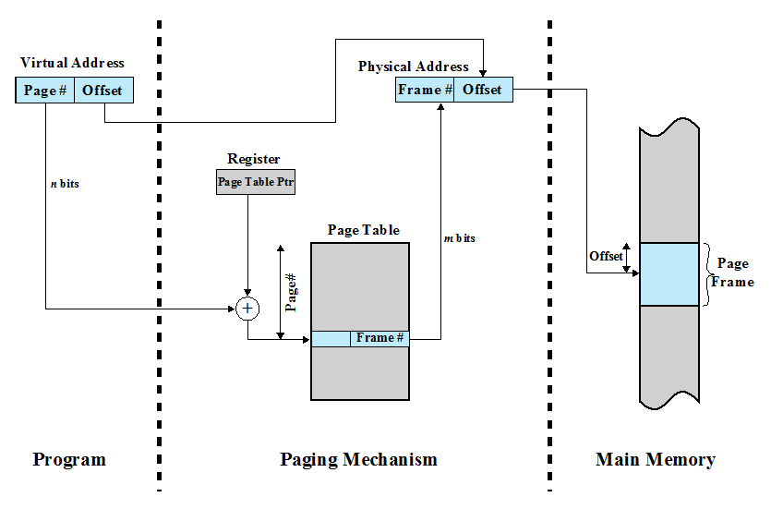
Page-table Base Register (Page Table Pointer)

Slide 16
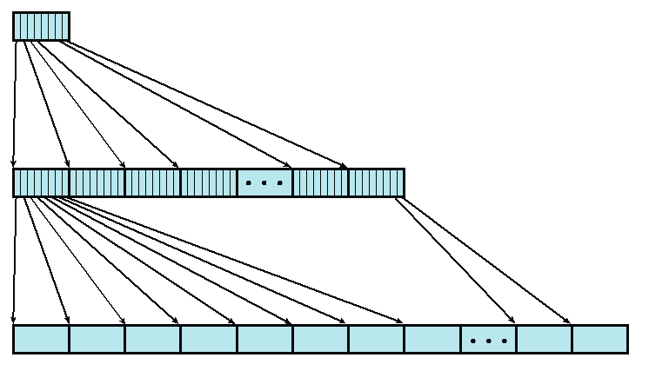
Two-Level Page Table
4KB root page table
Assume (1) we have 4-byte page table entry. (2) page size is 4KB
1. How many root page table entries?
User Page Table
2. How many user page table entries?
3. How large is the user address space?
Notes:
An example of a two-level scheme typical for use with a
32-bit address. If we assume byte-level addressing and 4-kbyte (2 ¹² ) pages, then the
4-Gbyte (2 ³² ) virtual address space is composed of 2 ²⁰ pages. If each of these pages
is mapped by a 4-byte page table entry, we can create a user page table composed of
2 ²⁰ PTEs requiring 4 Mbytes (2 ²² ). This huge user page table, occupying 2 ¹⁰ pages,
can be kept in virtual memory and mapped by a root page table with 2 ¹⁰ PTEs occupying
4 Kbyte (2 ¹² ) of main memory.

Slide 17
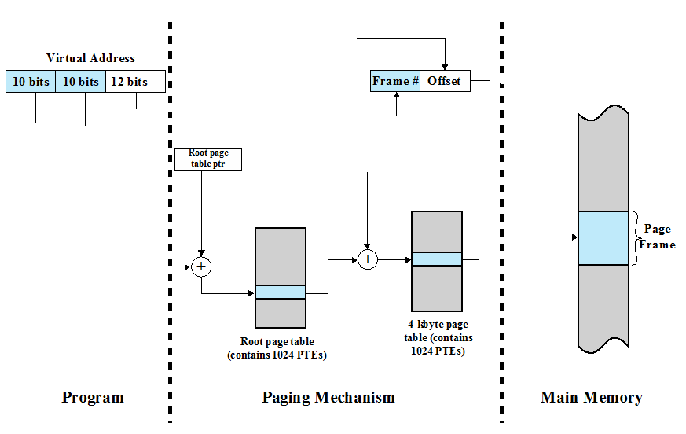
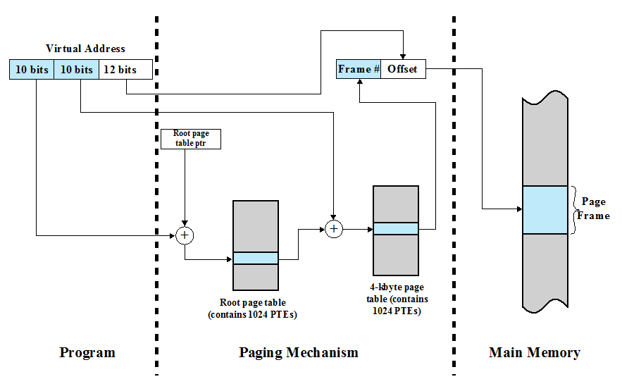
Address Translation in the Two-Level Paging System

Slide 18
Design virtual address format for a two-level paging system
Suppose you design a two-level page translation scheme where page size is 16MB and page table entry size is 16 bytes.
What is the format of a 64-bit virtual address?

Slide 19
Memory Accesses in the Paging Scheme
To load an instruction or data from main memory, how many memory accesses are required in the paging scheme?
two memory accesses
One for the page table and one for the data / instruction
What is the problem with respect to memory access?
The two memory access problem can be solved by the use of a special fast-lookup hardware cache called associative memory or translation look-aside buffers (TLBs)

Slide 20
Address Space ID in TLBs
Why some TLBs store address-space identifiers (ASIDs) in each TLB entry – uniquely identifies each process?
To provide address-space protection for that process

Slide 21
Effective Memory Access Time
Associative Lookup = Ttlb time unit
TLB hit ratio = h
percentage of times that a page number is found in the associative registers;
T_hit = T_tlb + T_mem
T_miss = T_tlb + T_mem + T_tlb_update + T_mem
access page table
access data
T_miss = T_tlb + T_mem + T_mem
Effective Access Time = h*T_hit + (1-h)*T_miss
Notes:
TLB update and accessing data in memory are performed in parallel
T_tlb_update << T_mem
Associative Lookup = Ttlb time unit
Can be < 10% of memory access time
Hit ratio = h
Hit ratio – percentage of times that a page number is found in the associative registers; ratio related to number of associative registers

Slide 22
Effective Access Time
Consider a single-level paging scheme. The TLB has 32 entries. The TLB access time is 10 ns; memory access time is 200ns.
How long does it take to access data in memory if there is a TLB hit?
How long does it take to access data in memory if there is a TLB miss?
What is the effective memory-access time if we have a TLB hit ratio of 80%?
What is the minimal hit ratio that guarantees the effective access time of at most 220ns?

Slide 23
Segment Organization
Each segment table entry contains the starting address of the corresponding segment in main memory and the length of the segment
A bit is needed to determine if the segment is already in main memory
Another bit is needed to determine if the segment has been modified since it was loaded in main memory
Notes:
In the discussion of simple segmentation, we indicated that each
process has its own segment table, and when all of its segments are loaded into main
memory, the segment table for a process is created and loaded into main memory.
Each segment table entry contains the starting address of the corresponding segment
in main memory, as well as the length of the segment. The same device, a segment
table, is needed when we consider a virtual memory scheme based on segmentation.
Again, it is typical to associate a unique segment table with each process. In this
case, however, the segment table entries become more complex ( Figure 8.1b ).
Because only some of the segments of a process may be in main memory, a bit is
needed in each segment table entry to indicate whether the corresponding segment
is present in main memory or not. If the bit indicates that the segment is in memory,
then the entry also includes the starting address and length of that segment.
Another control bit in the segmentation table entry is a modify bit, indicating
whether the contents of the corresponding segment have been altered since the segment
was last loaded into main memory. If there has been no change, then it is not
necessary to write the segment out when it comes time to replace the segment in the
frame that it currently occupies. Other control bits may also be present. For example,
if protection or sharing is managed at the segment level, then bits for that purpose
will be required.
Segmentation allows the programmer to view memory as consisting of multiple address spaces or segments.
Segments may be of unequal, indeed dynamic, size.
Memory references consist of a form of address (segment number, offset).
This organization has a number of advantages to the programmer over a nonsegmented address space:
It simplifies the handling of growing data structures.
If the programmer doesn’t know ahead of time how large a particular data structure will become, it is necessary to guess unless dynamic segment sizes are allowed. With segmented virtual memory, the data structure can be assigned its own segment, and the operating system will expand or shrink the segment as needed.
If a segment that needs to be expanded is in main memory and there is insufficient room, the operating system may move the segment to a larger area of main memory, if available, or swap it out. The enlarged segment would be swapped back in at the next opportunity.
,,
2. It allows programs to be altered and recompiled independently,
without requiring the entire set of programs to be relinked and reloaded.
Again, this is accomplished using multiple segments.
3. It lends itself to sharing among processes.
A programmer can place a utility program or a useful table of data in a segment that can be referenced by other processes.
4. It lends itself to protection.
Because a segment can be constructed to contain a well-defined set of programs or data, the programmer or system administrator can assign access privileges in a convenient fashion.

Slide 24
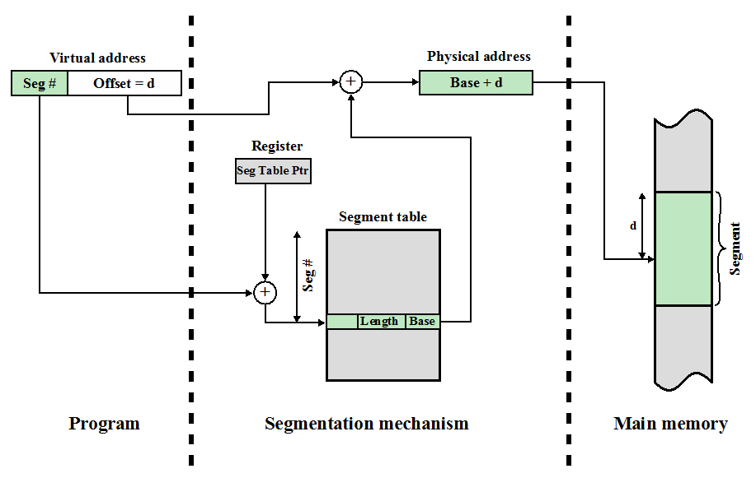
Address Translation in a Segmentation System
Notes:
The basic mechanism for reading a word from memory involves the translation
of a virtual, or logical, address, consisting of segment number and offset, into a physical
address, using a segment table. Because the segment table is of variable length,
depending on the size of the process, we cannot expect to hold it in registers. Instead,
it must be in main memory to be accessed. Figure 8.11 suggests a hardware implementation
of this scheme (note similarity to Figure 8.2 ). When a particular process
is running, a register holds the starting address of the segment table for that process.
The segment number of a virtual address is used to index that table and look up the
corresponding main memory address for the start of the segment. This is added to
the offset portion of the virtual address to produce the desired real address.

Slide 25
Combined Paging and Segmentation
A user’s address space is broken up into a number of segments.
Each segment is broken up into a number of fixed-sized pages
Each page is equal in length to a main memory frame
Segmentation is visible to the programmer
Paging is transparent to the programmer
Notes:
Question: segments in a page or pages in a segment?
Both paging and segmentation have their strengths. Paging, which is transparent
to the programmer, eliminates external fragmentation and thus provides efficient
use of main memory. In addition, because the pieces that are moved in and out of
main memory are of fixed, equal size, it is possible to develop sophisticated memory
management algorithms that exploit the behavior of programs, as we shall see.
Segmentation, which is visible to the programmer, has the strengths listed earlier,
including the ability to handle growing data structures, modularity, and support
for sharing and protection. To combine the advantages of both, some systems are
equipped with processor hardware and operating system software to provide both.
In a combined paging/segmentation system, a user’s address space is broken
up into a number of segments, at the discretion of the programmer. Each segment
is, in turn, broken up into a number of fixed-size pages, which are equal in length to
a main memory frame. If a segment has length less than that of a page, the segment
occupies just one page. From the programmer’s point of view, a logical address still
consists of a segment number and a segment offset. From the system’s point of view,
the segment offset is viewed as a page number and page offset for a page within the
specified segment.

Slide 26
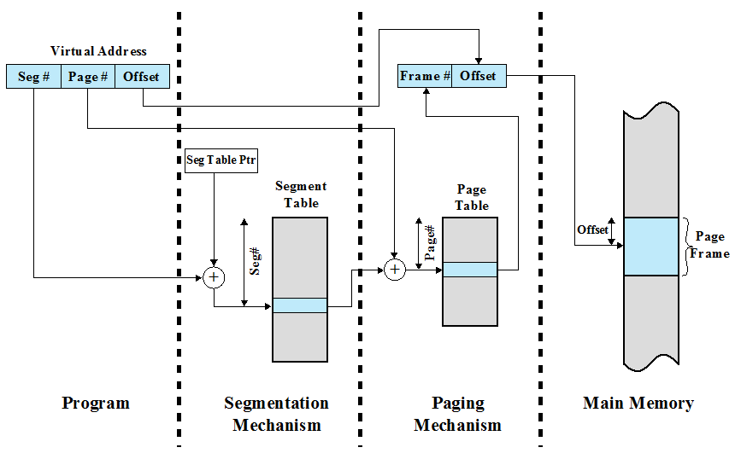
Address Translation in a Segmentation/Paging System
Notes:
This figure suggests a structure to support combined paging/segmentation
(note similarity to Figure 8.4 ). Associated with each process is a segment table and
a number of page tables, one per process segment. When a particular process is
running, a register holds the starting address of the segment table for that process.
Presented with a virtual address, the processor uses the segment number portion to
index into the process segment table to find the page table for that segment. Then
the page number portion of the virtual address is used to index the page table and
look up the corresponding frame number. This is combined with the offset portion
of the virtual address to produce the desired real address.

Slide 27
Notes:
Figure c suggests the segment table entry and page table entry formats. As
before, the segment table entry contains the length of the segment. It also contains
a base field, which now refers to a page table. The present and modified bits are not
needed because these matters are handled at the page level. Other control bits may
be used, for purposes of sharing and protection. The page table entry is essentially
the same as is used in a pure paging system. Each page number is mapped into a corresponding
frame number if the page is present in main memory. The modified bit
indicates whether this page needs to be written back out when the frame is allocated
to another page. There may be other control bits dealing with protection or other
aspects of memory management.

Slide 28
Fetch Policy
Determines when a page should be brought into memory
Two main types:
Demand Paging
Prepaging
Notes:
The fetch policy determines when a page should be brought into main memory. The
two common alternatives are demand paging and prepaging.

Slide 29
Demand Paging
Brings pages into main memory when a reference is made to a location on the page
Many or few page faults when process is first started?
What happens after more and more pages are brought in?
Principle of locality suggests that as, most future references will be to pages that have recently been brought in, and page faults should drop to a very low level
Notes:
Many page faults.
With demand paging ,
a page is brought into main memory only when a reference is made to a location on
that page. If the other elements of memory management policy are good, the following
should happen. When a process is first started, there will be a flurry of page
faults. As more and more pages are brought in, the principle of locality suggests that
most future references will be to pages that have recently been brought in. Thus,
after a time, matters should settle down and the number of page faults should drop
to a very low level.

Slide 30
Prepaging
Pages other than the one demanded by a page fault are brought in
Exploits the characteristics of most secondary memory devices
If pages of a process are stored contiguously in secondary memory it is more efficient to bring in a number of pages at one time
What is the downside?
Ineffective if extra pages are not referenced
Notes:
With prepaging , pages other than the one demanded by a page fault are
brought in. Prepaging exploits the characteristics of most secondary memory
devices, such as disks, which have seek times and rotational latency. If the pages of
a process are stored contiguously in secondary memory, then it is more efficient to
bring in a number of contiguous pages at one time rather than bringing them in one
at a time over an extended period. Of course, this policy is ineffective if most of the
extra pages that are brought in are not referenced.
The prepaging policy could be employed either when a process first starts up,
in which case the programmer would somehow have to designate desired pages, or
every time a page fault occurs. This latter course would seem preferable because
it is invisible to the programmer. However, the utility of prepaging has not been
established [MAEK87].
Prepaging should not be confused with swapping. When a process is swapped
out of memory and put in a suspended state, all of its resident pages are moved out.
When the process is resumed, all of the pages that were previously in main memory
are returned to main memory.

Slide 31
Placement Policy
Determines where in real memory a process piece is to reside
Important design issue in a segmentation system
Paging or combined paging with segmentation placing is irrelevant because hardware performs functions with equal efficiency
For NUMA systems an automatic placement strategy is desirable
Notes:
The placement policy determines where in real memory a process piece is to reside.
In a pure segmentation system, the placement policy is an important design issue;
policies such as best-fit, first-fit, and so on, which were discussed in Chapter 7 , are
possible alternatives. However, for a system that uses either pure paging or paging
combined with segmentation, placement is usually irrelevant because the address
translation hardware and the main memory access hardware can perform their
functions for any page-frame combination with equal efficiency.
There is one area in which placement does become a concern, and this is a
subject of research and development. On a so-called nonuniform memory access
(NUMA) multiprocessor, the distributed, shared memory of the machine can be
referenced by any processor on the machine, but the time for accessing a particular
physical location varies with the distance between the processor and the memory
module. Thus, performance depends heavily on the extent to which data reside
close to the processors that use them [LARO92, BOLO89, COX89]. For NUMA
systems, an automatic placement strategy is desirable to assign pages to the memory
module that provides the best performance.

Slide 32
Replacement Policy
Deals with the selection of a page in main memory to be replaced when a new page must be brought in
Objective: the page that is removed should be the page least likely to be referenced in the near future
The more elaborate the replacement policy the greater the hardware and software overhead to implement it
Notes:
In most operating system texts, the treatment of memory management includes a
section entitled “replacement policy,” which deals with the selection of a page in
main memory to be replaced when a new page must be brought in. This topic is
sometimes difficult to explain because several interrelated concepts are involved:
• How many page frames are to be allocated to each active process
• Whether the set of pages to be considered for replacement should be limited
to those of the process that caused the page fault or encompass all the page
frames in main memory
• Among the set of pages considered, which particular page should be selected
for replacement
We shall refer to the first two concepts as resident set management , which is dealt
with in the next subsection, and reserve the term replacement policy for the third
concept, which is discussed in this subsection.
The area of replacement policy is probably the most studied of any area of
memory management. When all of the frames in main memory are occupied and
it is necessary to bring in a new page to satisfy a page fault, the replacement policy
determines which page currently in memory is to be replaced. All of the policies
have as their objective that the page that is removed should be the page least likely
to be referenced in the near future. Because of the principle of locality, there is
often a high correlation between recent referencing history and near-future referencing
patterns. Thus, most policies try to predict future behavior on the basis of
past behavior. One trade-off that must be considered is that the more elaborate and
sophisticated the replacement policy, the greater will be the hardware and software
overhead to implement it.

Slide 33
Basic Algorithms
Algorithms used for the selection of a page to replace:
Optimal
Least recently used (LRU)
First-in-first-out (FIFO)
Clock
Notes:
Regardless of the resident set management strategy (discussed
in the next subsection), there are certain basic algorithms that are used for the
selection of a page to replace. Replacement algorithms that have been discussed in
the literature include
• Optimal
• Least recently used (LRU)
• First-in-first-out (FIFO)
• Clock

Slide 34
Least Recently Used (LRU)
Replaces the page that has not been referenced for the longest time
By the principle of locality, this should be the page least likely to be referenced in the near future
Notes:
The least recently used (LRU) policy replaces the page in memory that has
not been referenced for the longest time. By the principle of locality, this should
be the page least likely to be referenced in the near future. And, in fact, the LRU
policy does nearly as well as the optimal policy. The problem with this approach is
the difficulty in implementation. One approach would be to tag each page with the
time of its last reference; this would have to be done at each memory reference,
both instruction and data. Even if the hardware would support such a scheme, the
overhead would be tremendous. Alternatively, one could maintain a stack of page
references, again an expensive prospect.

Slide 35
Amazon Interview Question for Software Engineer / Developers
Implement an LRU cache
How to implement LRU?
one approach is to tag each page with the time of last reference
this requires a great deal of overhead
Notes:
Reference:
1. http://www.roseindia.net/java/example/java/util/LRUCacheExample.shtml
2. http://www.careercup.com/question?id=63645

Slide 36
First-in-First-out (FIFO)
Treats page frames allocated to a process as a circular buffer
Pages are removed in round-robin style
A Simple replacement policy to implement
Page that has been in memory the longest is replaced
Notes:
The first-in-first-out (FIFO) policy treats the page frames allocated to a process
as a circular buffer, and pages are removed in round-robin style. All that is
required is a pointer that circles through the page frames of the process. This is
therefore one of the simplest page replacement policies to implement. The logic
behind this choice, other than its simplicity, is that one is replacing the page that
has been in memory the longest: A page fetched into memory a long time ago may
have now fallen out of use. This reasoning will often be wrong, because there will
often be regions of program or data that are heavily used throughout the life of a
program. Those pages will be repeatedly paged in and out by the FIFO algorithm.

Slide 37
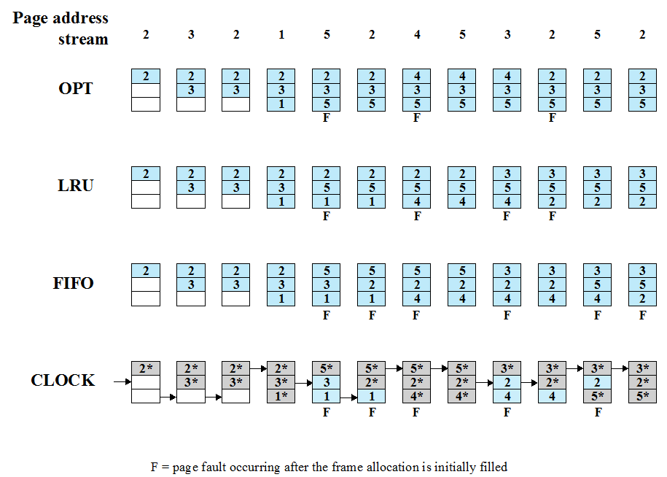
Notes:
The optimal policy selects for replacement that page for which the time to the next
reference is the longest. It can be shown that this policy results in the fewest number of
page faults [BELA66]. Clearly, this policy is impossible to implement, because it would
require the operating system to have perfect knowledge of future events. However, it
does serve as a standard against which to judge real-world algorithms.
Figure 8.14 gives an example of the optimal policy. The example assumes a
fixed frame allocation (fixed resident set size) for this process of three frames. The
execution of the process requires reference to five distinct pages. The page address
stream formed by executing the program is
2 3 2 1 5 2 4 5 3 2 5 2
which means that the first page referenced is 2, the second page referenced is 3, and
so on. The optimal policy produces three page faults after the frame allocation has
been filled.

Slide 38
File Management
File is a named, ordered collection of information
What are a file manager’s responsibilities?
Storing the information on a device
Mapping the block storage to a logical view
Allocating/deallocating storage
Providing file directories
Notes:
What abstraction should be presented to programmer?

Slide 39
Information Structure
Applications
Records
Structured Record Files
Record-Stream Translation
Byte Stream Files
Stream-Block Translation
Storage device
Notes:
From the user’s point of view, one of the most important parts of an operating
system is the file system. The file system provides the resource abstractions typically
associated with secondary storage. The file system permits users to create data
collections, called files, with desirable properties, such as:
• Long-term existence: Files are stored on disk or other secondary storage and
do not disappear when a user logs off.
• Sharable between processes: Files have names and can have associated access
permissions that permit controlled sharing.
• Structure: Depending on the file system, a file can have an internal structure
that is convenient for particular applications. In addition, files can be organized
into hierarchical or more complex structure to reflect the relationships
among files.

Slide 40
Can you design the following byte stream file interface?
fileID = open(fileName)
close(fileID)
read(fileID, buffer, length)
write(fileID, buffer, length)
seek(fileID, filePosition)

Slide 41
Low Level Files
fid = open(“fileName”,…);
…
read(fid, buf, buflen);
…
close(fid);
...
...
b₀
b₁
b₂
b_{i}
int open(…) {…}
int close(…) {…}
int read(…) {…}
int write(…) {…}
int seek(…) {…}
Stream-Block Translation
Storage device response to commands

Slide 42
Structured Files
Records
Record-Block Translation

Slide 43
Record-Oriented Sequential Files
Logical Record
fileID = open(fileName)
close(fileID)
getRecord(fileID, record)
putRecord(fileID, record)
seek(fileID, position)

Slide 44
File Operations
File is an abstract data type
Create
Write
Read
Reposition within file
Delete
Truncate
Open(F_{i}) – search the directory structure on disk for entry F_{i}, and move the content of entry to memory
Close (F_{i}) – move the content of entry F_{i} in memory to directory structure on disk
Notes:
Ask a question.

Slide 45
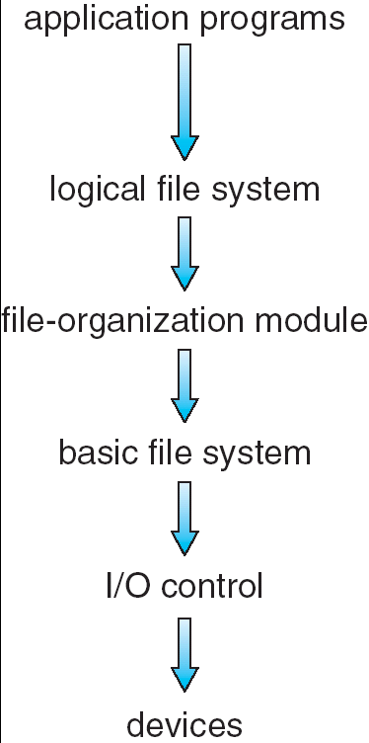
Implementing Low Level Files
Secondary storage device contains ?
Volume directory (sometimes a root directory for a file system)
External file descriptor for each file
The file contents
Manages blocks
Assigns blocks to files (descriptor keeps track)
Keeps track of available blocks
Maps to/from byte stream
Notes:
Give an example of my senior design project. Real-time disk scheduling.
Illustrate why file systems must be organized into layers

Slide 46
File Descriptors
External name
Current state
Sharable
Owner
User
Locks
Protection settings
Length
Time of creation
Time of last modification
Time of last access
Reference count
Storage device details
How to design a file control block (a.k.a., file descriptor)?
From “File Systems Requirements” to “File Attributes”
From “File Attributes” to “a File Control Block”
Notes:
Reference: http://pages.cs.wisc.edu/~bart/537/lecturenotes/figures/demos-fs.gif

Slide 47
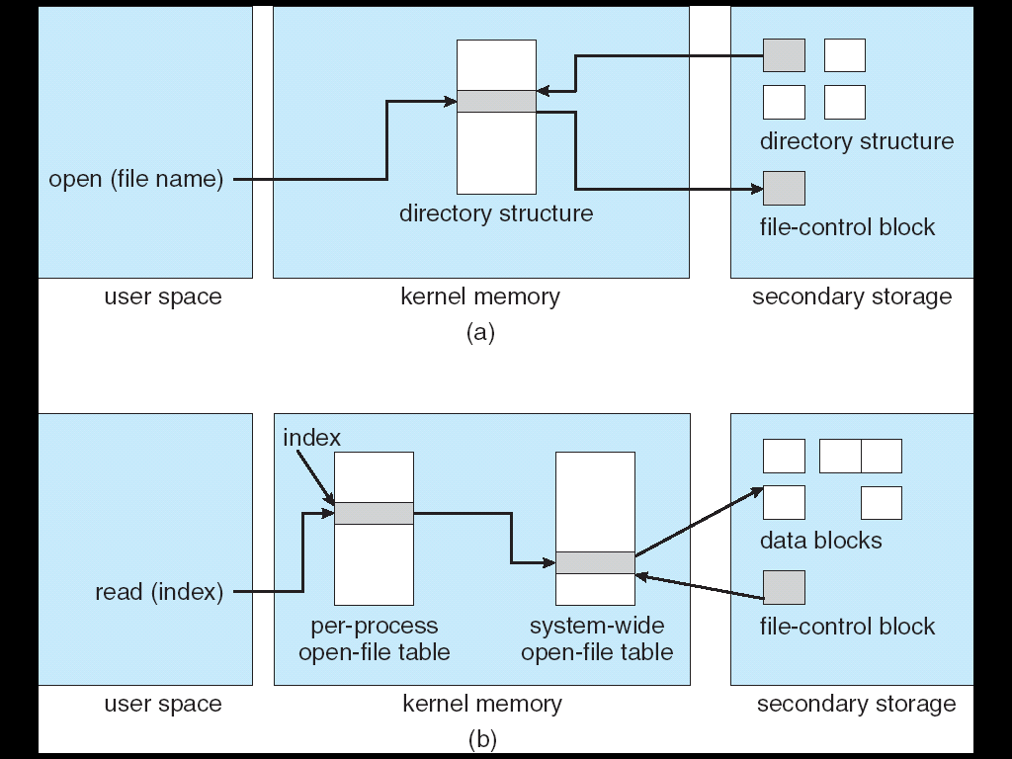
In-Memory File System Structures

Slide 48
An open() Operation
Locate the on-device (external) file descriptor
Extract info needed to read/write file
Authenticate that process can access the file
Create an internal file descriptor in primary memory (“System-wide”)
Create an entry in a “per process” open file status table
Allocate resources, e.g., buffers, to support file usage

Slide 49
File Manager Data Structures
2
Keep the state of the process-file session
1
Copy info from external to the open file descriptor
Open File
Descriptor
3
Return a reference to the data structure
Process-File
Session
External File Descriptor

Slide 50
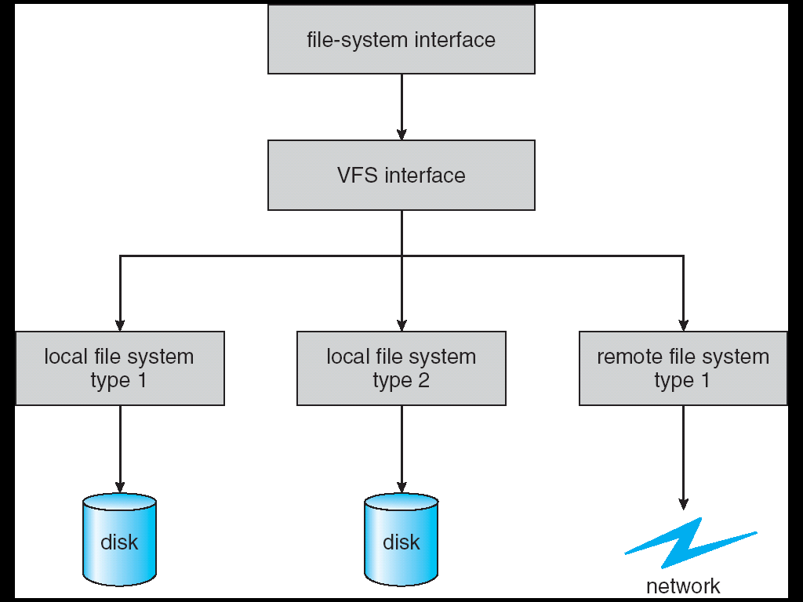
Schematic View of a Virtual File System
Notes:
Virtual File Systems (VFS) provide an object-oriented way of implementing file systems.
VFS allows the same system call interface (the API) to be used for different types of file systems.
The API is to the VFS interface, rather than any specific type of file system.

Slide 51
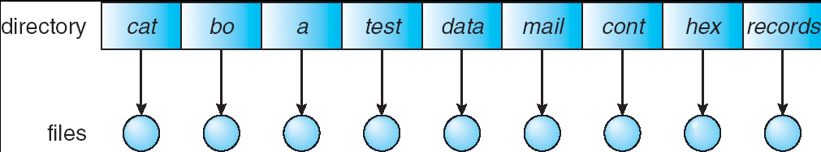
Single-Level Directory
A single directory for all users
Good News? Problems?
Naming problem
Grouping problem

Slide 52
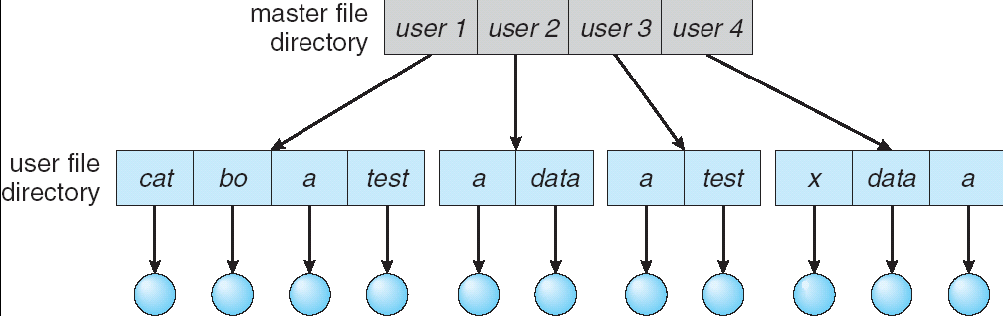
Two-Level Directory
Separate directory for each user
Advantages? Problems?
Path name
Can have the same file name for different user
Efficient searching
No grouping capability

Slide 53
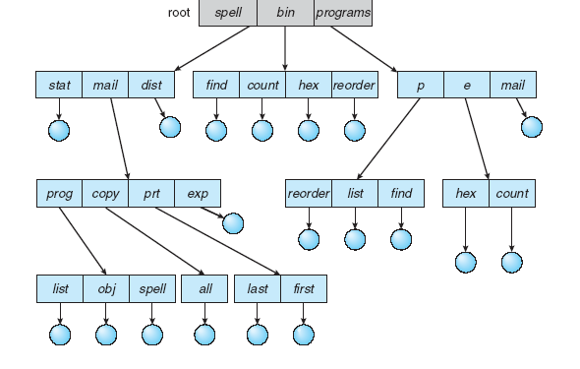
Tree-Structured Directories
Notes:
Efficient searching
Grouping Capability
Current directory (working directory)
cd /spell/mail/prog
type list

Slide 54
Block Management
The job of selecting & assigning storage blocks to the file
For a fixed sized file of k blocks
File of length m requires N = ⎡m/k⎤ blocks
Byte b_{i} is stored in block ⎣i/k⎦
Three basic strategies:
Contiguous allocation
Linked lists
Indexed allocation

Slide 55
Contiguous Allocation
Maps the N blocks into N contiguous blocks on the secondary storage device
Difficult to support dynamic file sizes
File descriptor
Head position 237
…
First block 785
Number of blocks 25

Slide 56
Linked Lists
Each block contains a header with
Number of bytes in the block
Pointer to next block
Blocks need not be contiguous
Files can expand and contract
Seeks can be slow
First block
…
Head: 417
...
Length
Length
Length
Byte 0
Byte 0
Byte 0
...
...
...
Byte 4095
Byte 4095
Byte 4095
Block 0
Block 1
Block N-1

Slide 57
Indexed Allocation
Extract headers and put them in an index
Simplify seeks
May link indices together (for large files)
Byte 0
...
Index block
…
Head: 417
...
Byte 4095
Length
Block 0
Byte 0
Length
...
Byte 4095
Byte 0
Block 1
...
Length
Byte 4095
Block N-1

Slide 58
inode
UNIX Files
mode
owner
…
Direct block 0
Direct block 1
…
Direct block 11
Single indirect
Double indirect
Triple indirect
Data
Data
Data
Index
Data
Index
Data
Index
Index
Index
Data
Index
Data
Index
Index
Data
Index
Data

Slide 59
Project 4: Data Structure What fields should be added in the thread struct?
Add two new fields in the thread struct:
pid: process ID
openfileTable (see also slides of Project 4: Part 4)
Notes:
a file descriptor (FD) is an abstract indicator for accessing a file.

Slide 60
Project 4: Design How to allocate (i.e., assign) PIDs?
Assign PID sequentially
Looping back to PIN_MIN when we reach PIN_MAX
Do not reuse the same PID quickly (no identical PIDs within a few minutes)

Slide 61
Project 4: Data Structure Process ID Management What is PID information or pidinfo? (see functions on slide 14)
Process id of the thread
Process id of its parent thread
Is it exited? True if it has exited
exitstatus (see Algorithm 2 on slide 19)
A condition variable: use to implement waitpid(), i.e., wait for thread exit
Notes:
Think about social security numbers.
Managed by social security administration.

Slide 62
Project 4: Process ID Management: Suggested Functions (see pidinfo on slide 11)
Initialization
Create and Destroy pidinfo
Given pid, retrieve pidinfo from pidinfoTable
Add a new pidinfo into the pidinfoTable
PID Allocation and Unallocation
Wait for PID (see also waitpid system call)
Set exitstatus of pidinfo

Slide 63
Project 4: How to allocate a PID? int pid_allocate(pid_t *retPID)
Lock pidlock;
Check: number of existing processes < MAX_PROCS
pidinfo_index = get_pidinfo_index(nextpid);
while (pidinfoTable[pidinfo_index] !available) {
increase nextpid;
pidinfo_index = get_pidinfo_index(nextpid);
}
pid = nextpid;
Increase nextpid;
new_pidinfo = create_pidinfo(pid, parent pid);
Add new_pidinfo into pidinfoTable;
Unlock pidlock;
Return pid;
Notes:
int get_pidinfo_index(nextpid) {
return(nextpid % MAX_PROCS);
}
Parent PID is current->pid

Slide 64
Project 4: How to Implement system call waitpid?
Userland:
int waitpid(pid_t pid, int *returncode, int flags);
Manual page: waitpid.html
Wait for the process specified by pid to exit
Return its exit code in the integer pointed to by returncode.
If that process has exited already, waitpid returns immediately. If that process does not exist, waitpid fails.
Notes:
int get_pidinfo_index(nextpid) {
return(nextpid % MAX_PROCS);
}
Parent PID is current->pid

Slide 65
Project 4: How to Implement system call sys_waitpid?
In Userland:
int waitpid(pid_t pid, int *returncode, int flags);
Two Implementation Strategies:
Strategy 2 is recommended. Why?
Implement this syscall in
Strategy 1: sys_waitpid()does everything
OR
Strategy 2: Let sys_waitpid() pass information to pid_wait() to do all the work.
Notes:
int get_pidinfo_index(nextpid) {
return(nextpid % MAX_PROCS);
}
Parent PID is current->pid

Slide 66
Project 4: How to implement system call pid_wait()?
In Kernel:
int
pid_wait(pid_t wpid, int *status, int flags, pid_t *ret)
This is a synchronization problem: use condition variable
A parent waits for its child
Notes:
int get_pidinfo_index(nextpid) {
return(nextpid % MAX_PROCS);
}
Parent PID is current->pid

Slide 67
Algorithm 2: pid_wait(pid_t wpid, int *status, int flags, pid_t *ret)
If (wait for itself) return EINVAL;
Lock pidlock;
wpidinfo = get_pidinfo(wpid);
If (wpidinfo’s parent pid != curthread->t_pid)
Unlock pidlock; return EPERM;
If (wpidinfo’s exited == false) {/* child is active */
if (flags == WNOHANG) { /* Optional */
Unlock pidlock; *ret = 0; return 0;
}
cv_wait(wpidinfo->pi_cv, pidlock);
}
*status = wpidinfo->exitstatus;
*ret = wpid;
Set wpidinfo’s parent pid to 0;
Remove wpidinfo from pidinfoTable;
Unlock pidlock;
Notes:
Note: you may support flags like WNOHANG (it is optional)
If (wpidinfo’s exited == false) /* child is active */
cv_wait(wpidinfo->pi_cv, pidlock);

Slide 68
Project 4: How to Implement system call _exit?
Userland: void _exit(int code);
Implement this syscall in
Strategy 1: sys_exit()does everything
OR
Strategy 2: Let sys_exit() calls thread_exit(), which does all the work.
Modify the existing thread_exit() function
Notes:
int get_pidinfo_index(nextpid) {
return(nextpid % MAX_PROCS);
}
Parent PID is current->pid

Slide 69
Project 5: Design Function 3 Options

Slide 70
Project 5: Data Structures
tlb entry: this is a building block for tlb
tlb: this is the TLB to speedup the address translation performance
physical_memory_t: what is the data structure?
page_table_t: what is the data structure?

